Slide 1
August 29th Meeting
Ainsley Lai

Slide 2
Agenda
Source Level vs. Speed and Frequency
Transferring data
I am unable to continue as I now have a position with NASA

Slide 3
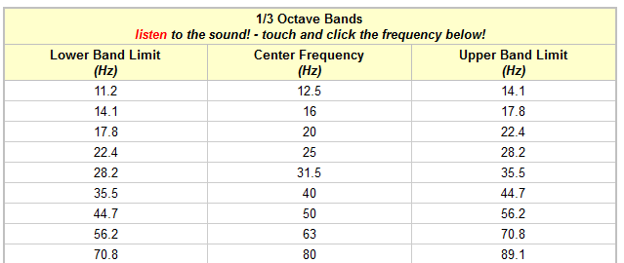
1/3 Octave Bands
Original Rx Level computation used 5-90 Hz band
Switch to compute 9 Rx levels using 9 different bands

Slide 4
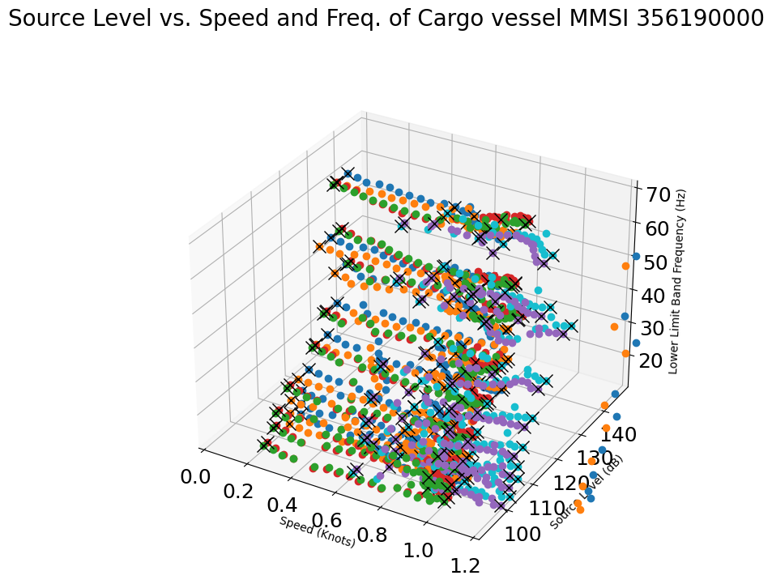
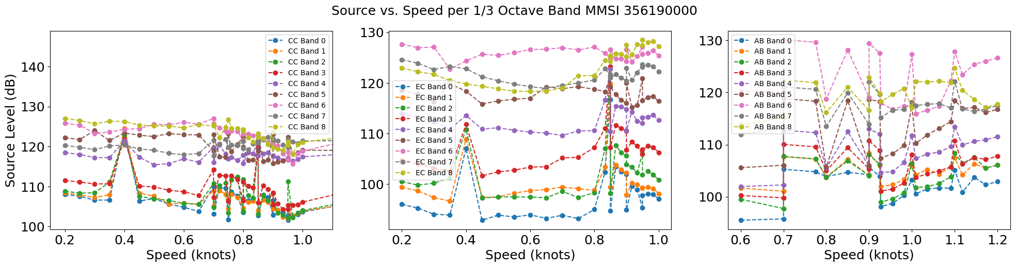
MMSI 356190000
CC = Blue, Orange
EC = Red, Green
AB = Cyan, Purple

Slide 5
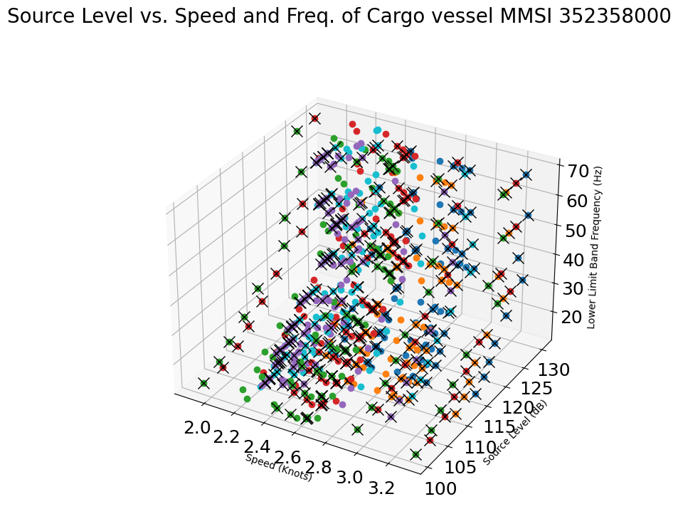
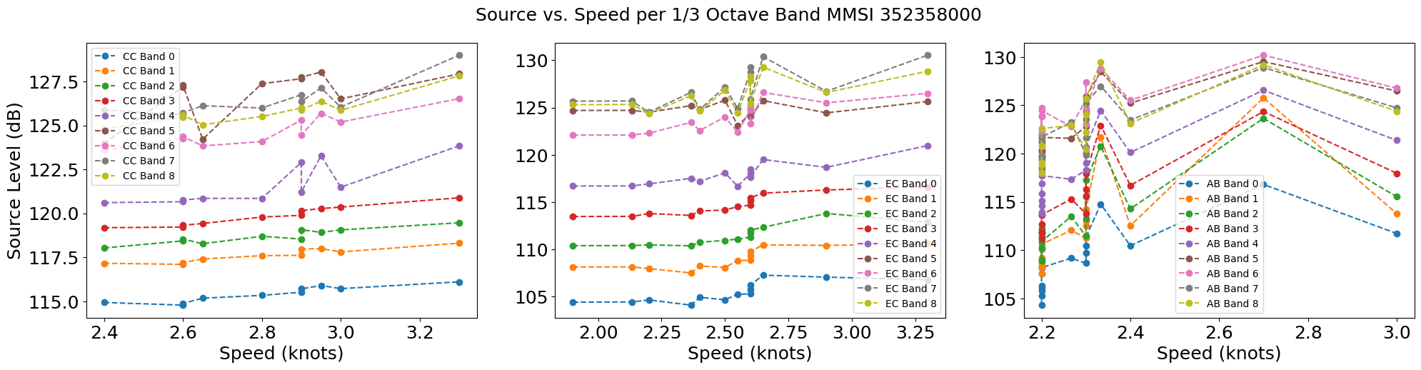
MMSI 352358000
CC = Blue, Orange
EC = Red, Green
AB = Cyan, Purple

Slide 6
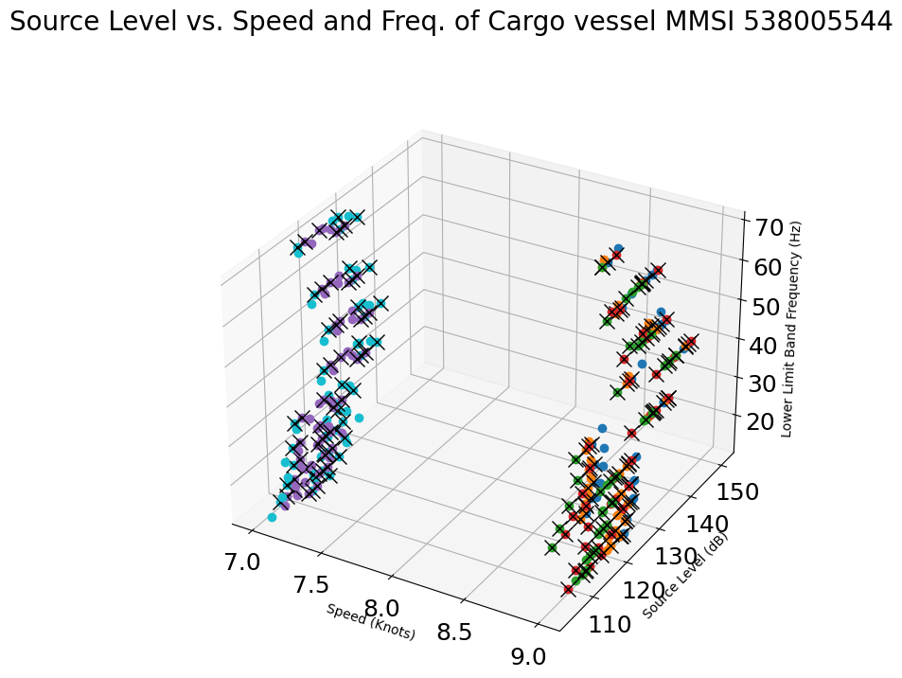
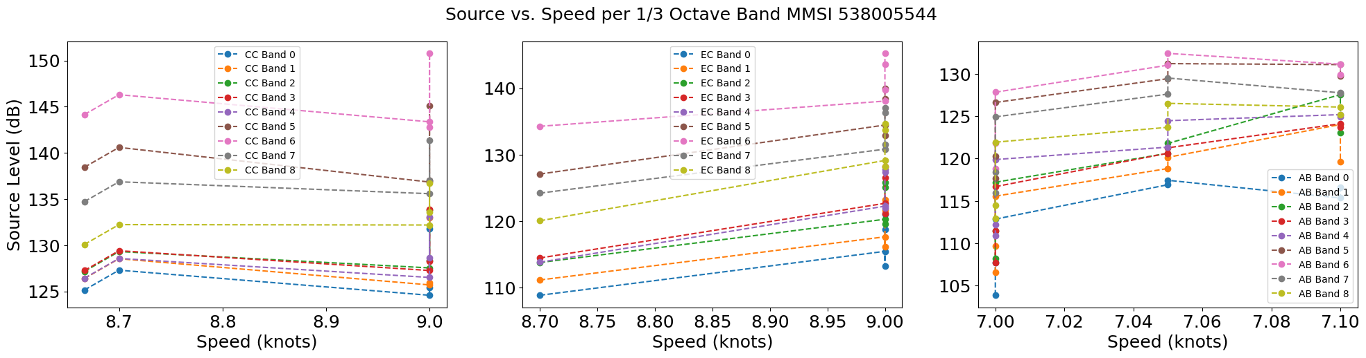
MMSI 538005544
CC = Blue, Orange
EC = Red, Green
AB = Cyan, Purple

